Slide 1






ASSALAMUWALAIKUM
Welcome to our Project Presentation
Supervised By –
MD. Al Mamun Khan
Lecturer
Department of Computer Science & Engineering
Ideal Institute of Business & Science

Slide 2






DreamNest
Real Estate Property Management System

Slide 3






Met Our Team
Asif Iqbal
Reg: 19502005235
Md. Manjurul Islam Reg: 19502005262

Slide 4
Introduction
The Real Estate Property Management System is a web-based platform designed to simplify property browsing, booking, and administrative management. It enables users to explore properties and make bookings, while administrators can efficiently manage listings, users, and booking requests through a secure dashboard.

Slide 5
Objectives
Provide a user-friendly platform for property searching and booking
Automate property management, reducing manual workload
Ensure secure authentication for users and admins
Maintain accurate records of properties, users, and bookings
Create a scalable and responsive MERN-based solution

Slide 6



Existing System
Traditional real estate processes are largely manual, requiring users to contact agents individually for property details. Booking confirmations often rely on phone calls or in-person meetings, and there is no centralized dashboard for administrators. As a result, transparency is limited, and tracking booking status becomes difficult for both users and admins.

Slide 7


Proposed System
The proposed web system digitizes and automates the real estate workflow.
Users can register, log in, browse available properties, and request bookings online.
Admins manage all backend operations including property updates, user management, and booking approvals from a dedicated dashboard.

Slide 8








Key Features
User:
Users can register, log in, browse and filter properties, view detailed listings, book properties with status tracking, check their booking history, and update their profile info.
Admin:
Admin login with role-based access, manage property listings, handle booking approvals, view registered users, and access a dashboard showing key stats and recent activity.

Slide 9


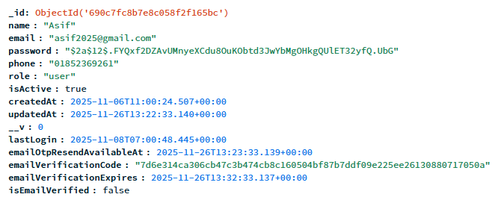

Database Design Overview
User Collection: name, email, password, phone, role, createdAt
Property Collection: title, description, price, type, location, images, createdAt
Booking Collection: userId, propertyId, status, date
All models are linked using Mongoose references for efficient queries.
Database

Slide 10



Tools and Technologies
Frontend: Type Script, Tailwind CSS, Axios, React Router
Backend: Node.js, Express.js
Database: MongoDB with Mongoose
Authentication: JWT, bcrypt
UI/UX: Responsive design, Framer Motion animations
Notifications: SweetAlert / Toast

Slide 11
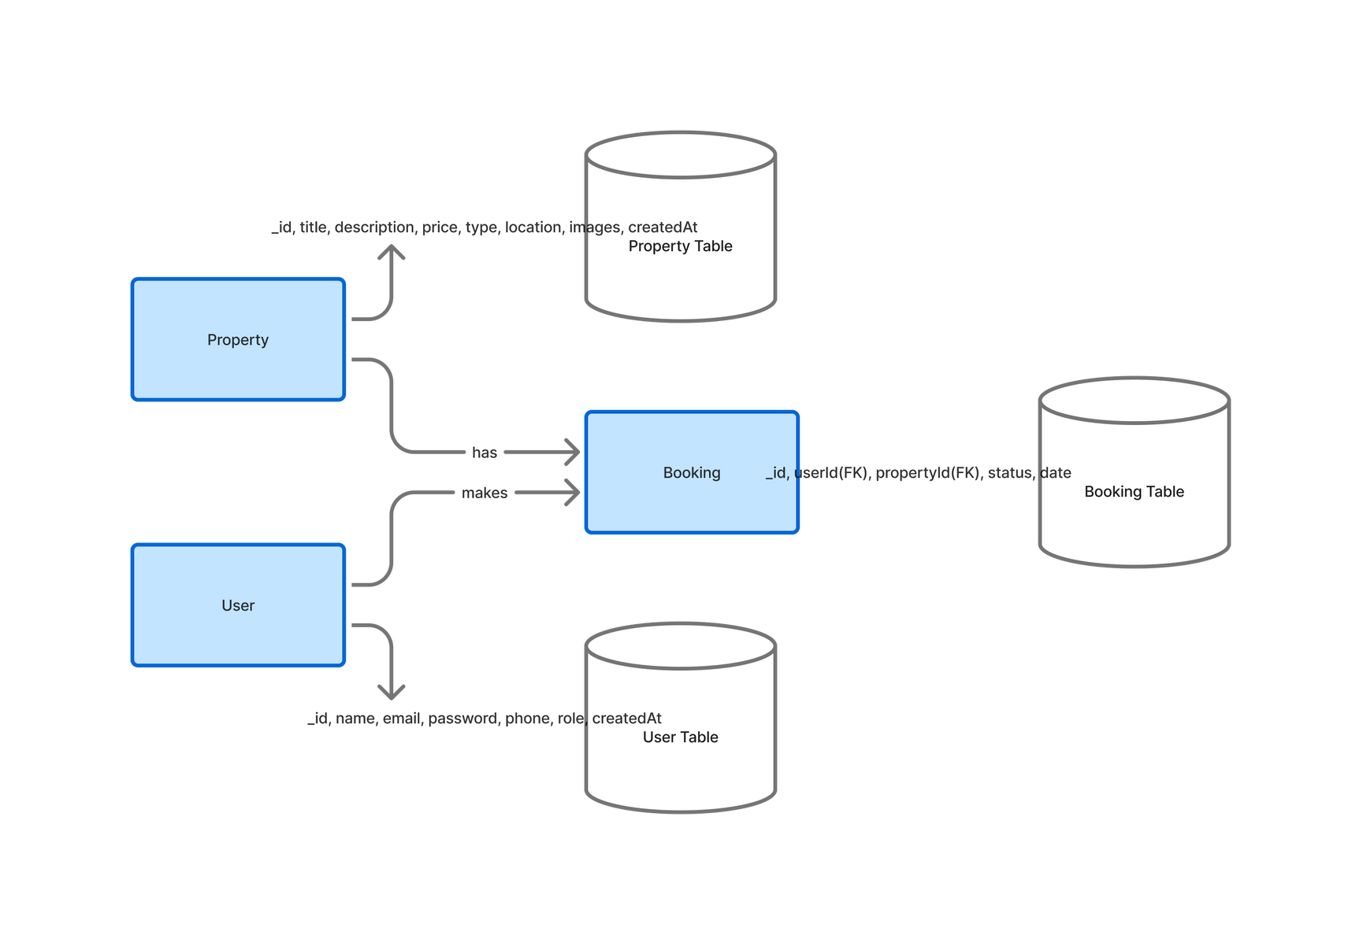
ER Diagram

Slide 12
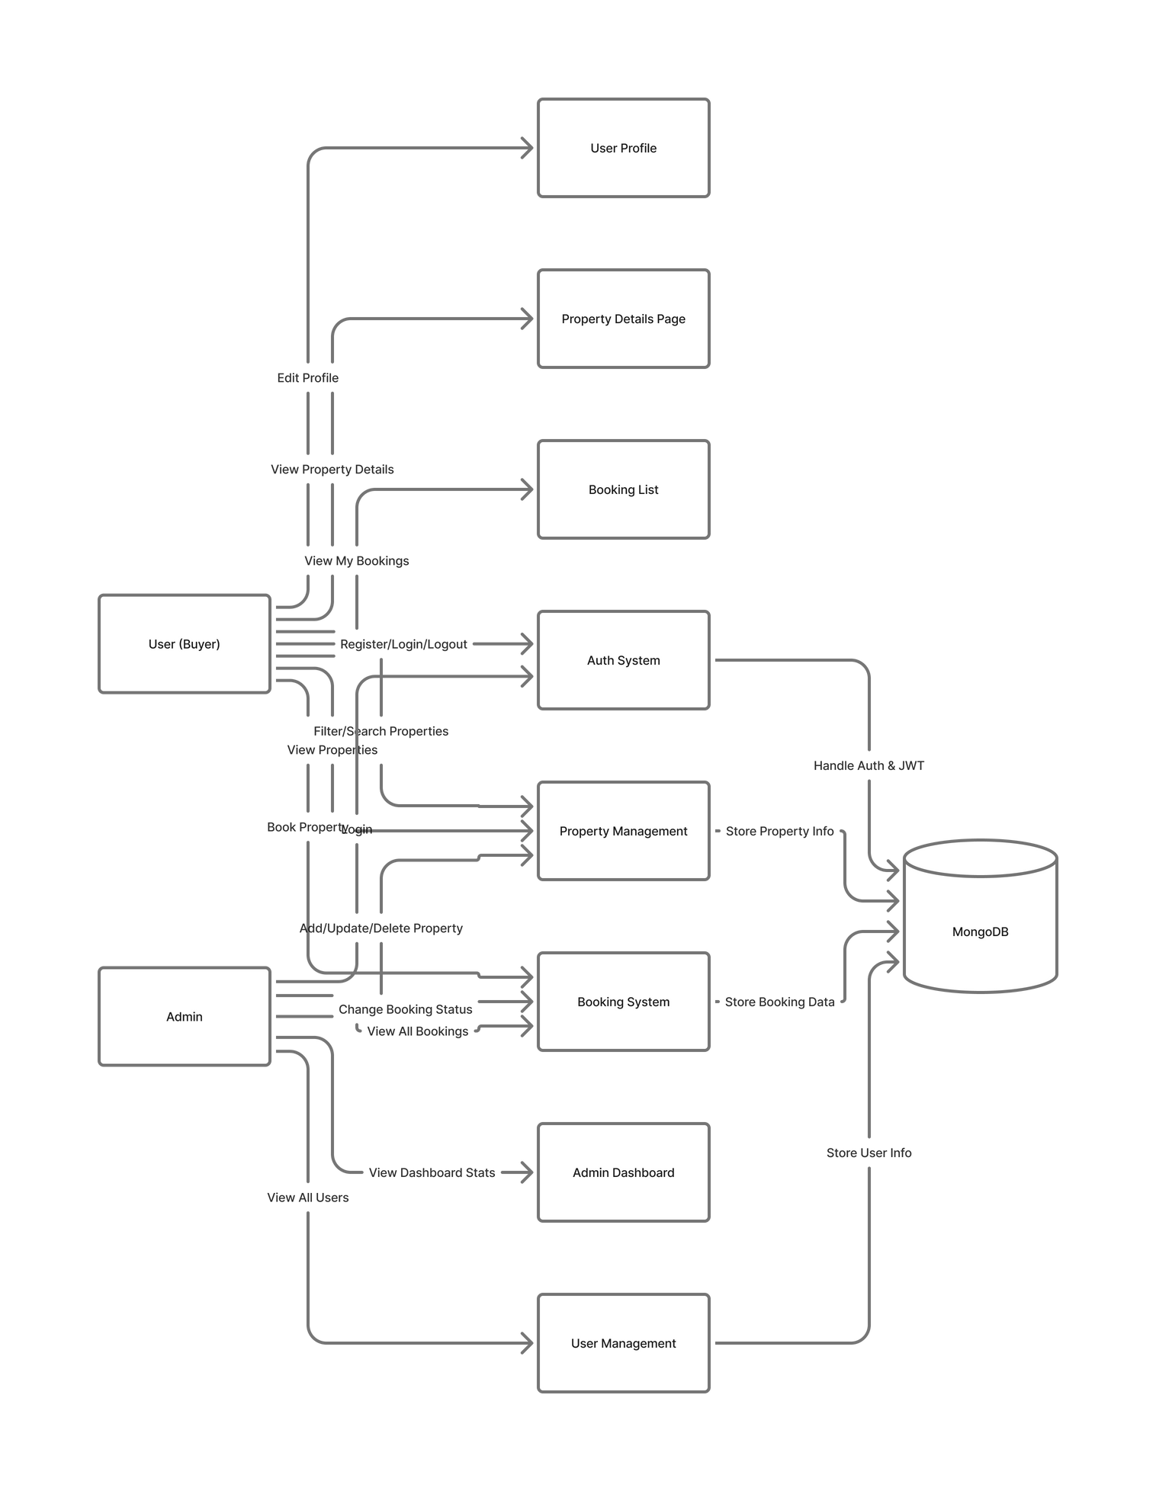
Use Case Diagram

Slide 13
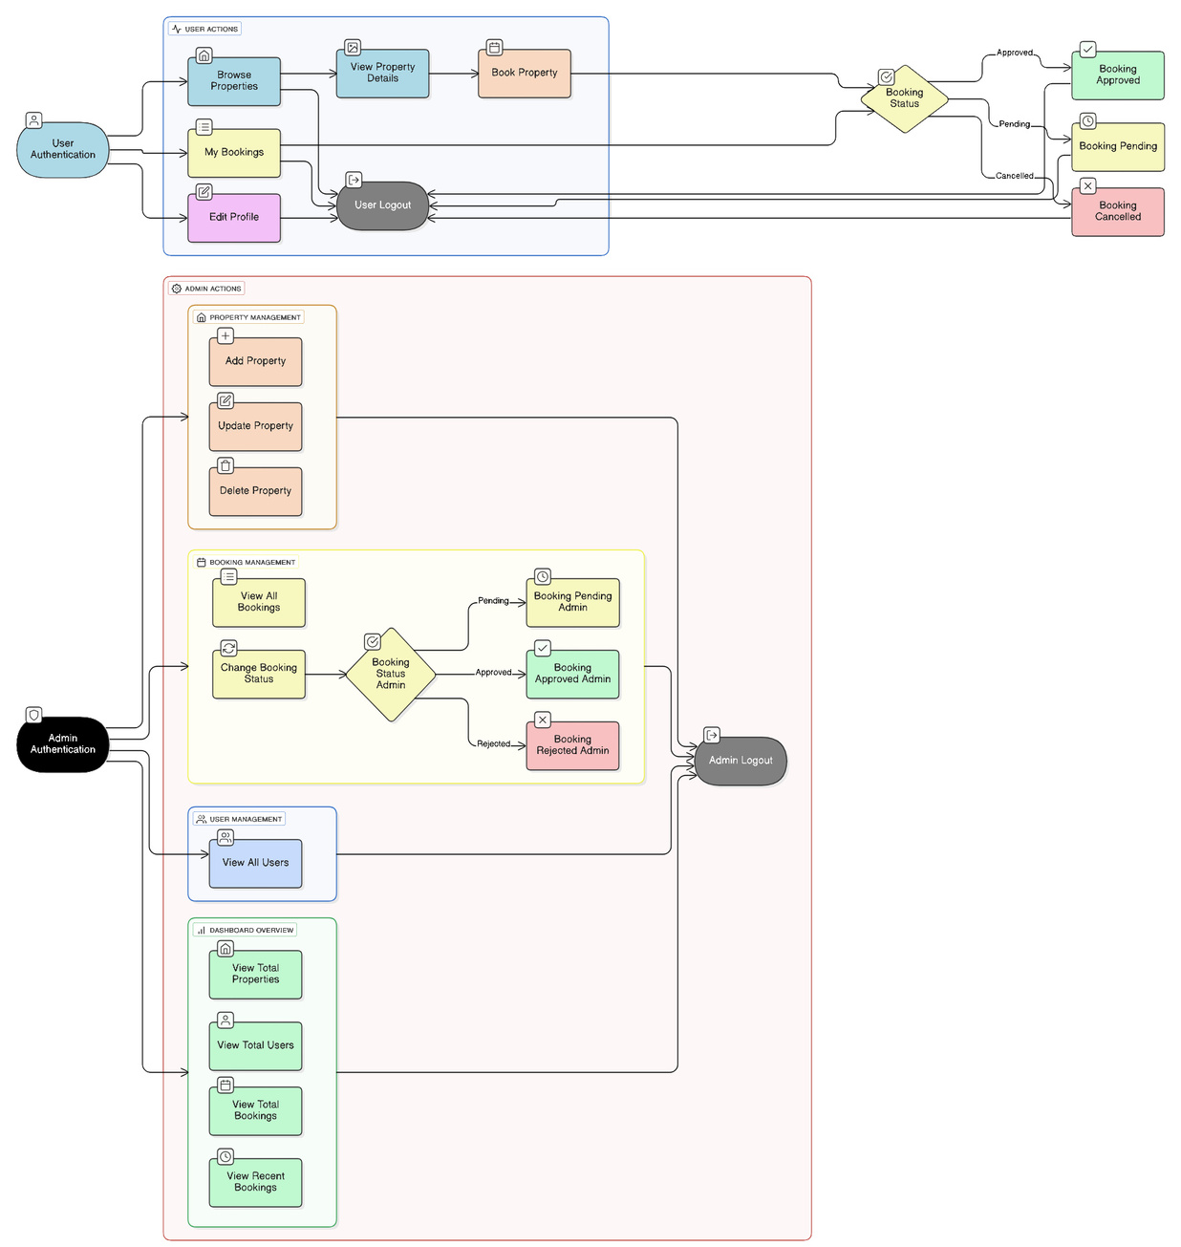
Data Flow Diagram

Slide 14
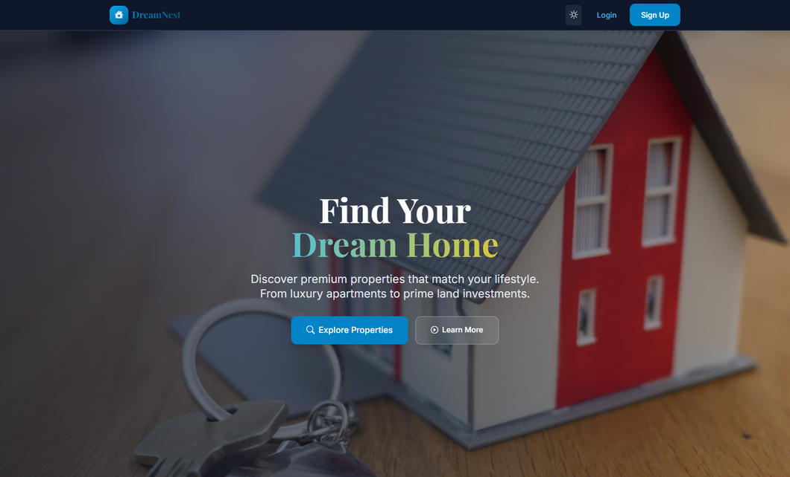
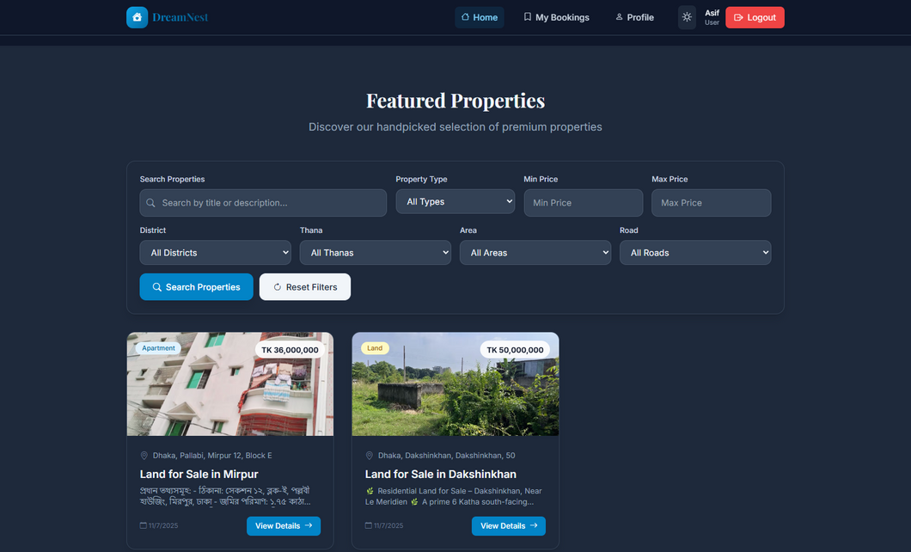
Home Page & Search Filter

Slide 15
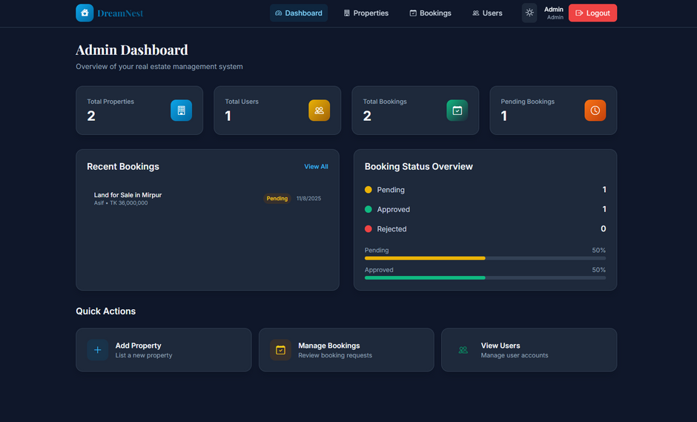
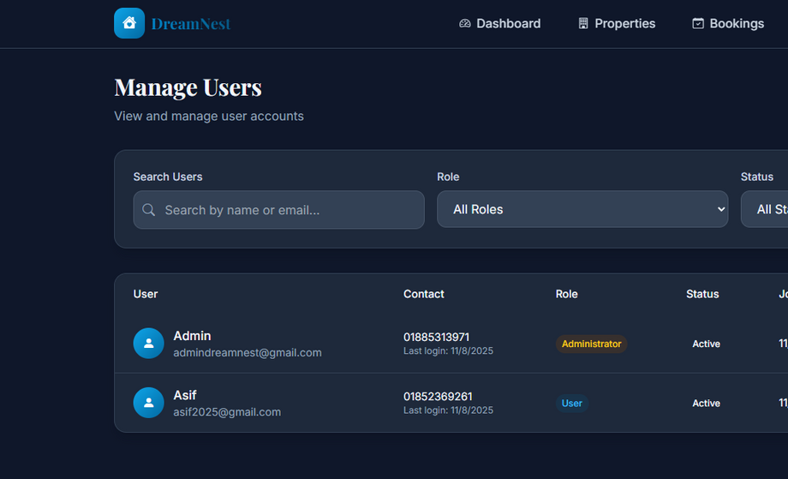
Admin Dashboard & Manage Users

Slide 16
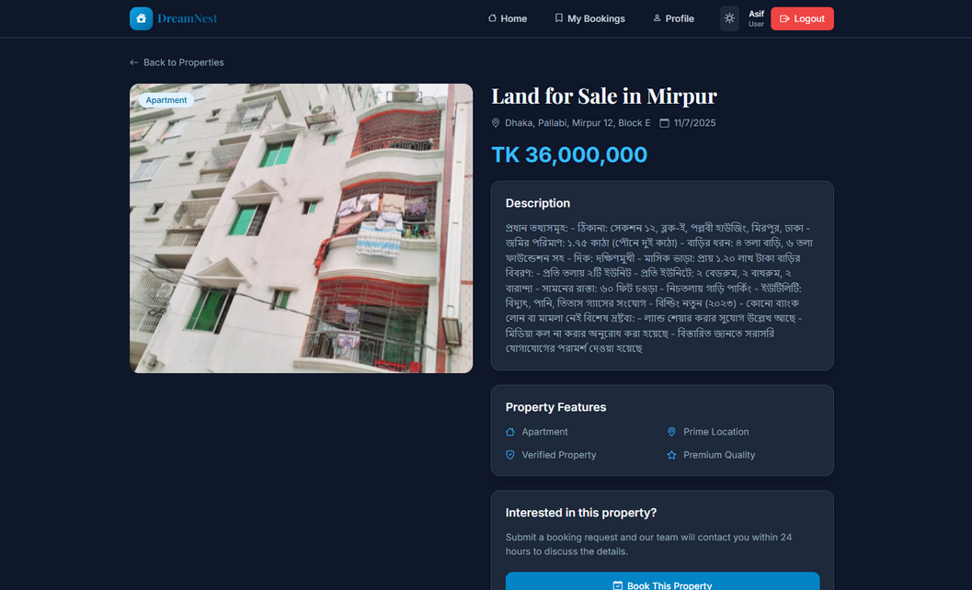
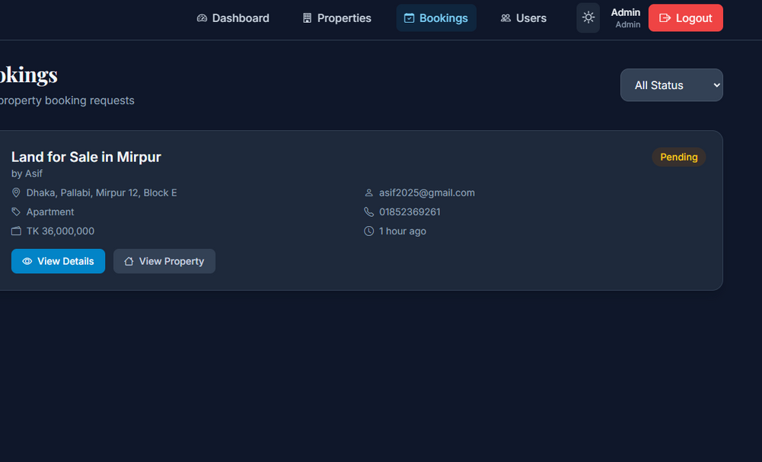
Booking Details & Manage Booking

Slide 17
Future Opportunities
Online payment integration (SSLCommerz / Stripe / UddoktaPay)
Real-time chat between users and agents
Advanced property recommendation using AI
Mobile application version (Android/iOS)
Geo-location based property suggestions
Automatic notification system (SMS / Email)

Slide 18

Thank you very much!

